Slide 1
An online Air Pollution Forecasting using LSTM and GRU
Authors Name: Davada Juned Aslam
Dr. Hemant K S
ICICTA-2022
Notes:
<number>

Slide 2
Content
Abstract
Introduction
Literature Review
Methodology
Result
Conclusion

Slide 3
Abstract
With the growing of industry we are facing the issue related to the air pollution on the daily basis. The air pollution can produce with the vehicle the chemical factory and many more.
With the development of the industry in the last few years. We are facing an issue related to air quality. We are not getting the proper air quality because of the pollution out there in the environment due to harmful gases from the industry
To address this problem of air pollution we are approaching the Deep Learning to overcome this with the help of RNN (Recurrent Neural Network) algorithm which are LSTM(Long-short term memory) and GRU(Gated Recurrent Unit).
We will take the input for previous 15 days of data and we are going to forecast the next 24 hours of pollution.
<number>

Slide 4
Introduction
With the development of industry In last few years , we have to comprise with the air quality quite a lot. Even though we are not getting the air quality as good as earlier.
Because of this polluted air quality many people are getting infected and getting a harmful disease like lung cancer and many more.
The air pollution could not just affect the human being it can affect the plant ecosystem also and it can even destroy the plant.
The air pollution depends upon the different parameters like the if the snow is there on that day then the Pollution will remain low on that day. And if there is no rain or no snow on that day then the pollution will be high on that day.
Other parameters like if the wind speed is more that the pollution on that area will remain low.
<number>

Slide 5
Cont..
In real time there are many website which are forecasting the weather but they are not prediction the air pollution.
They are showing the air pollution data which they have collected using the sensors.
Our system will forecast the Air pollution similar to the weather forecasting by collecting the previous days data and give it to the model which has created using the LSTM(Long Short term memory) and GRU(Gated Recurrent Unit).
We have to give the last 15 days of data and it will forecast the 24 hours of data.
<number>

Slide 6
Literature review
Deep Learning approaches have become more popular in last few years[1]. The most popular Deep Learning techniques are Multi-Layer Perceptron (MLP), Deep Belief Network (DBN), Convolutional Neural Networks (CNN), Recurrent Neural Network (RNN), and Auto Encoder (AE).We will use Recurrent Neural network for our work to obtain the result.
Many researchers are working on this problem of air pollution forecasting nowadays. Mostly they are focusing on the LSTM (Long short term memory) or GRU (Gated Recurrent Unit). But in this research, we are going to combine both of the famous models of Recurrent Networks. In many fields, these 2 models are giving their best to provide the solution to the problem.
The LSTM model can work more efficient the on the hourly basis concentration of the air pollutions. In this studies they have worked with the real time data of vishakapatnam for the 12 hours of air pollutions. Based on this data we can say that we can use the data LSTM for the air pollution forecasting.
<number>

Slide 7
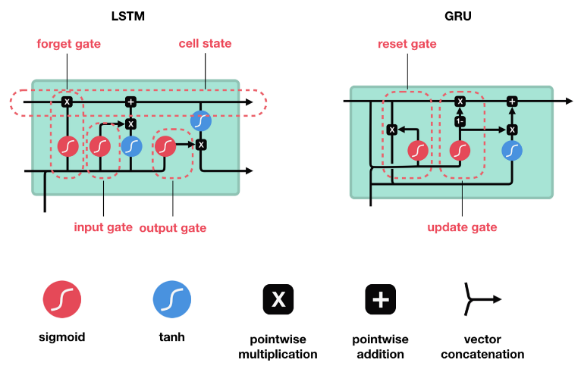
Methodology
In this research we are going to use the famous Recurrent Neural Network algorithm which are LSTM(Long Short term memory) and GRU(Gated Recurrent Unit).
<number>

Slide 8
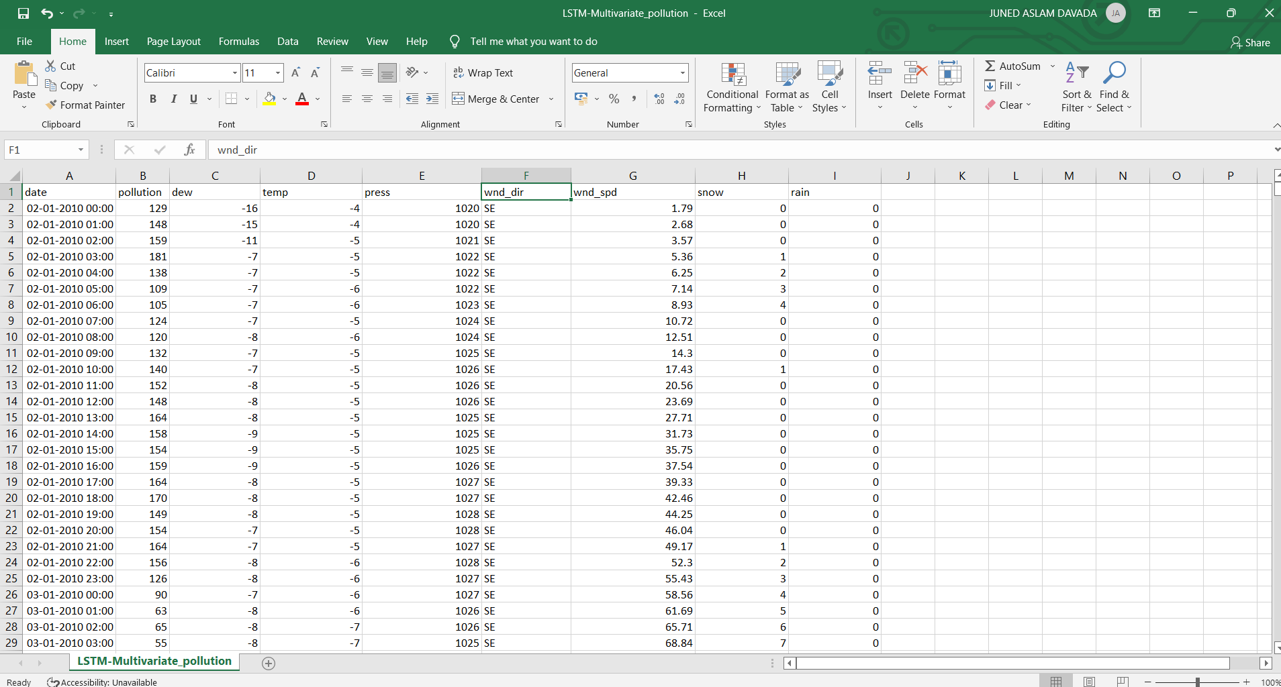
Cont..
<number>

Slide 9
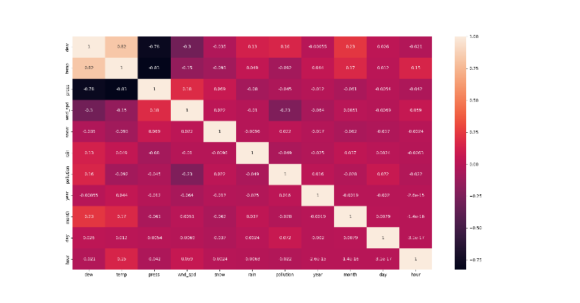
Cont..
<number>

Slide 10
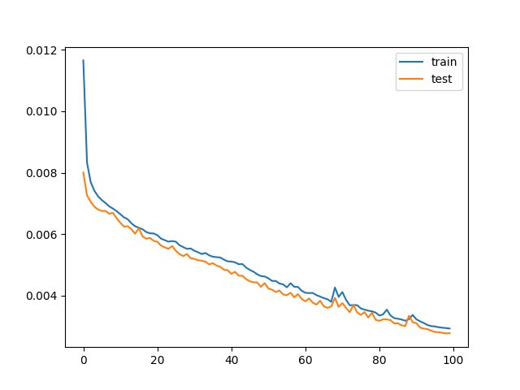
Results
We have created the model with the different epoch values with the values of 100 epoch , 200 epoch and 300 epoch.
This is the model for 100 epoch with the output graph. The graph include loss and Validation loss.
<number>

Slide 11
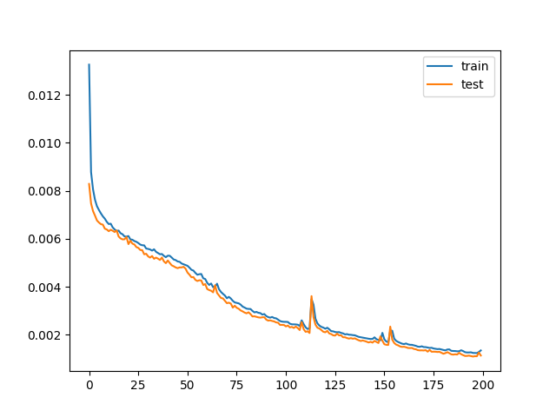
Cont..
This is the model for 200 epoch with the output graph. The graph include loss and Validation loss.
<number>

Slide 12
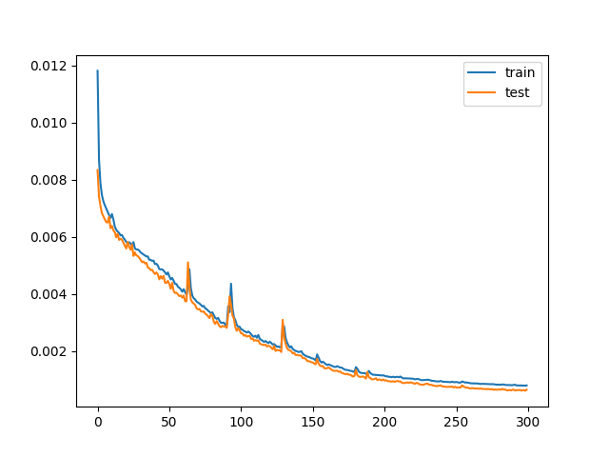
Cont..
This is the model for 300 epoch with the output graph. The graph include loss and Validation loss.
<number>

Slide 13
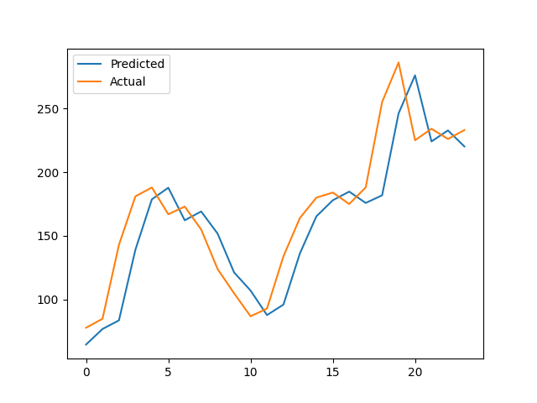
Cont..
This is the Actual values and Predicted values graph for the data which our model has predicted for the forecasting. Using 200 epoch model.
<number>

Slide 14
Conclusion
The motive of this paper is to understand that how we can use Recurrent Neural Network for the air pollutions forecasting. With the help of this model we can forecast the air pollution and we can see when the air pollution is going to be high. The result of work carried out supports the idea of a deep learning-based technique for forecasting air quality achieving promising performance.
<number>

Slide 15
THANK YOU
ICICTA-2022

